Slide 1
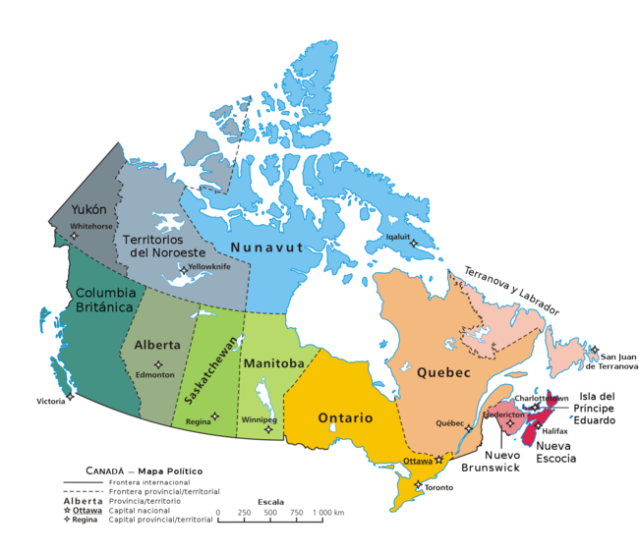
CANADA
Hello, I am talking about Canada

Slide 2
Localitation and habitants
Canada is located in North America. It is about 5.000.000 km2.It has got about 35 million inhabitants.

Slide 3
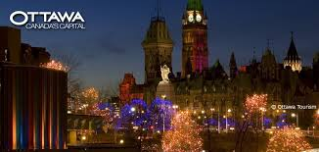
CAPITAL
The capital of Canada is Ottawa

Slide 4

FLAG
The flag has a vertical triband of red and white with the red maple leaf centred on the white band.

Slide 5
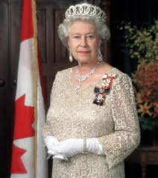
The queen Isabel II

Slide 6
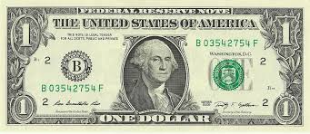
THE COIN
The coin is the dollar

Slide 7
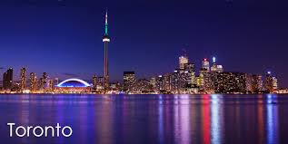


CITIES
Canada has got many important cities to visit like Toronto,Montreal and Vancouver

Slide 8

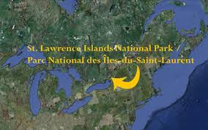
PARKS IN CANADA

Slide 9

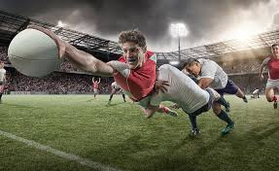
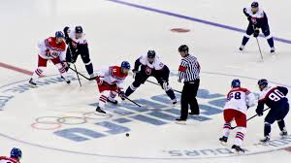
SPORTS
You can do sports like rugby ,ice hockey and basketball

Slide 10
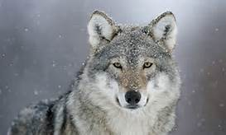
ANIMALS
The fauna of Canada is very interesting.Canada has got about 70000 known species of plants and animals,like large predators such as the grey wolf and the brown bear.

Slide 11
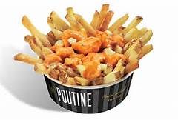
FOOD
The most popular and traditional dish in the canda is poutine.Poutine is a mixture of chips,cheese and meat sauce.You can find it in all the restaurant.

Slide 12
PERSONAL OPINION
Canada is a great country to visit. It is multicultural and it is considered a Melting Pot.
Canada is known for its natural resources such as the beautiful Niagara Falls I would like to visit one day.

