Slide 1
PROJECT 3
WALES

Slide 2
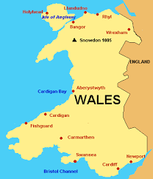
Wales comprises a peninsula in central-western Britain.This is one of the four countries that form the UK. Its capital is Cardiff. Its official language is Welsh and English. The queen of Wales is Elizabeth II.

Slide 3
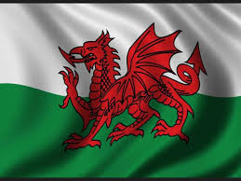
The flag is white and green with a red dragon in the middle

Slide 4
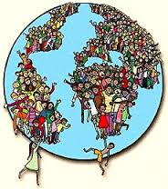
Wales has twenty thousand seven hundred seventy – nine (20.779) square kilometres.
The total population is 3.063.456 inhabitants.

Slide 5
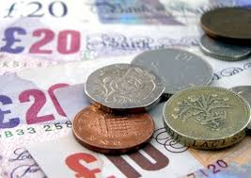
It’s currency is the pound sterling.

Slide 6
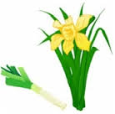
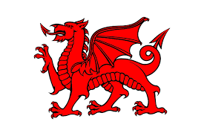
It’s main symbol is the red dragon. Another national emblems are the leek and daffodil.
THE LEEK AND DAFFODIL
RED GRAGON WALES

Slide 7
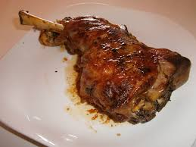
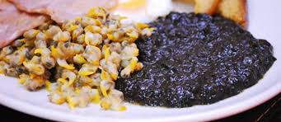
The lamb is the meet traditionally associated with Wales cooking. Wales gastronomy often includes seafood. This is reflected in the use of cockles and seaweed.
LAMB
COCKLES AND SEAWEED

Slide 8
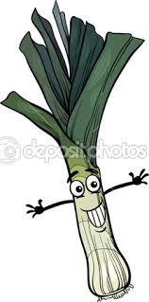
The leek is also very common in Wales cousine.

Slide 9
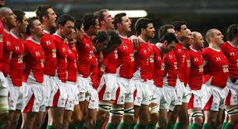
The Wales rugby team is currently fouth in the world ranking of rugby.

Slide 10
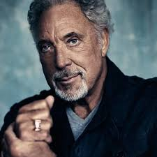
The great singer Tom Jones is from Wales.

Slide 11
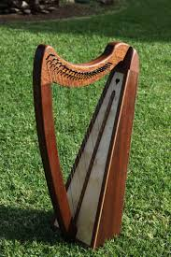
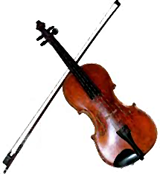
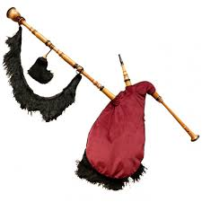
It's most typical instruments are:
The bagpipes
The violin
The celtic harp

Slide 12
THE END

